Slide 1
Database design and Applications CSIZG518/SEZG518/SSZG518)(S1-21)
Uma Maheswari

Slide 2
Session 2
Topic : Database Design Process

Slide 3
LEARNING OUTCOME
Design of Database phases.
ER Modelling concepts
EER Concepts
REFER: T1-Chapter 3 and 4;
Sections:
3.1, 3.3-3.9, 4.1-4.3, 4.6

Slide 4
REVIEW of DBMS TERMS
Notes:
Schema – the overall design of DB that is not expected to change frequently
A database schema is the skeleton structure that represents the logical view of the entire database. It defines how the data is organized and how the relations among them are associated. It formulates all the constraints that are to be applied on the data.
Schema for the Big data applications is not done up front as with non big data applications
Metadata- data about data
Data dictionary – A special file that stores metadata.
Data model - Data models define how data is connected to each other and how they are processed and stored inside the system.

Slide 5
Phases of Database Design

Slide 6
Phases of Database Design
1. Requirements specification and analysis
2. Conceptual design
3. Logical design
4. Physical design

Slide 7
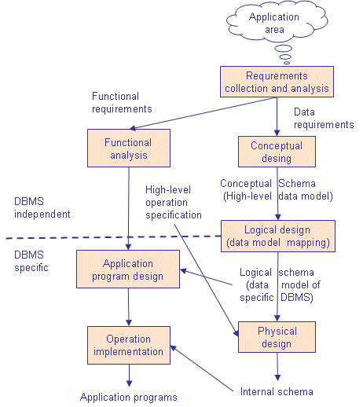
Phases of Database Design
Notes:
Note that some phases are database management system independent and some are dependent. The idea is to design first the database without thinking about the actual database system - just to concentrate on the data.

Slide 8
Phases of Database Design
1. Requirements specification and analysis
The requirements and the collection analysis phase produce both data requirements and functional requirements.
The data requirements are used as a source of database design.
The data requirements should be specified in as detailed and complete form as possible.

Slide 9
Phases of Database Design
2. Conceptual design
The result of this phase is an Entity-Relationship (ER) diagram or UML class diagram. It is a high-level data model of the specific application area.
It describes how different entities (objects, items) are related to each other. It also describes what attributes (features) each entity has. It includes the definitions of all the concepts (entities, attributes) of the application area.
During or after the conceptual schema design, the basic data model operations can be used to specify the high-level user operations identified during the functional analysis. This also serves to confirm that the conceptual schema meets all the identified functional requirements.
Notes:
In parallel with specifying the data requirements, it is useful to specify the known functional requirements of the application. These consist of user-defined operations that will be applied to the database (retrievals and updates). The functional requirements are used as a source of application software design. Of course some functions may produce also needs for database design.
1. Once all the requirements have been collected and analayzed, the next step is to create a conceptual schema for the database, using a high level conceptual data model. This phase is called conceptual design.

Slide 10
Phases of Database Design
3. Logical design
A. create relation schemas:
The result of the logical design phase (or data model mapping phase) is a set of relation schemas. The ER diagram or class diagram is the basis for these relation schemas.
To create the relation schemas is quite a mechanical operation. There are rules how the ER model or class diagram is transferred to relation schemas.
The relation schemas are the basis for table definitions. In this phase (if not done in previous phase) the primary keys and foreign keys are defined.

Slide 11
Phases of Database Design
3. Logical design
B. Normalization
Normalization is the last part of the logical design. The goal of normalization is to
eliminate redundancy and potential update anomalies.
Redundancy means that the same data is saved more than once in a database. Update anomaly is a consequence of redundancy. If a piece of data is saved in more than one place, the same data must be updated in more than one place.
Normalization is a technique by which one can modify the relation schema to reduce the redundancy. Each normalization phase adds more relations (tables) into the database.

Slide 12
Phases of Database Design
4. Physical design
The goal of the last phase of database design, physical design, is to implement the database. At this phase one must know which database management system (DBMS) is used.
For example, different DBMS's have different names for datatypes and have different datatypes.
The SQL clauses to create the database are written. The indexes, the integrity constraints (rules) and the users' access rights are defined.
Finally the data to test the database is added in.

Slide 13
Eg, UNIVERSITY database
STEP A: ANALYZE THE PROBLEM
Step1 :
What does this DB do?
Information concerning students, courses, and grades in a university environment
Step2 :
What are the Data records?
STUDENT
COURSE
SECTION
GRADE_REPORT
PREREQUISITE
Step 3:
Step Specify structure of records of each file by specifying data type for each data
element
String of alphabetic characters
Integer
Etc.

Slide 14
UNIVERSITY database contd…
Step B: Relate the records.
Step 4: Construct UNIVERSITY database
Store data to represent each student, course, section, grade report, and prerequisite as a record in appropriate file
Step 5: Relationships among the records
Step 6: Manipulation involves querying and updating

Slide 15
Examples of Queries and Updates:
Examples of queries:
Retrieve the transcript
List the names of students who took the section of the ‘Database’ course offered in fall 2008 and their grades in that section
List the prerequisites of the ‘Database’ course
Examples of updates:
Change the class of ‘Smith’ to sophomore
Create a new section for the ‘Database’ course for this semester
Enter a grade of ‘A’ for ‘Smith’ in the ‘Database’ section of last semester

Slide 16
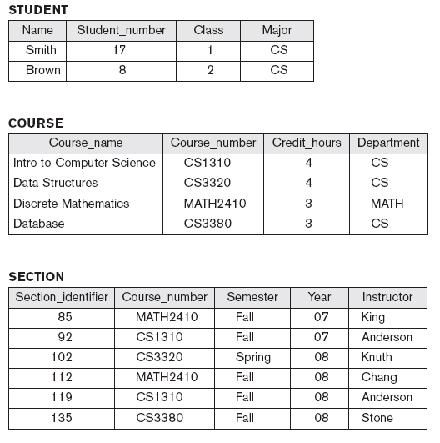
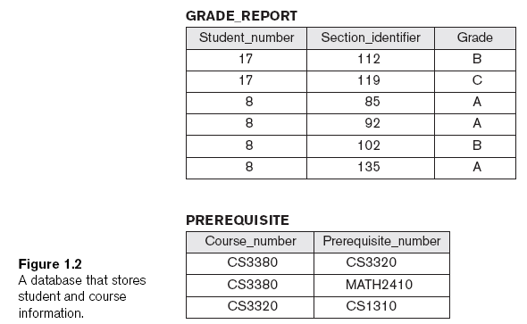
UNIVERSITY Database designed as:

Slide 17
Conceptual design of DB

Slide 18
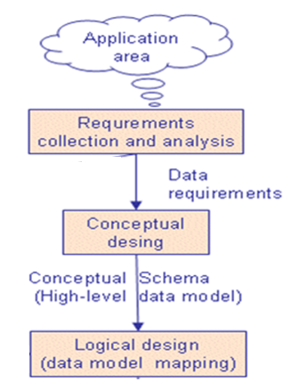
Conceptual Database Design:
it’s a High-level data model
The information gathered in the requirements analysis step is used to develop a high-level description of the data to be stored in the database, along with the constraints that are known to hold over this data.
Deliverable or outcome of conceptual design would be ER/EER model or UML model.

Slide 19
Domains, Attributes, Tuples, and Relations
Notes:
1. For each attribute associated with an entity set, we must identify a domain of possible
values. For example, the domain associated with the attribute name of Employees
might be the set of 20-character strings.

Slide 20
SEMANTIC DATA MODEL

Slide 21
ENTITY RELATIONSHIP

Slide 22
Roadmap for ER design
ENTITY and its types strong, weak
Attributes and its types
Keys
Primary , Foreign , Super , Candidate , Composite
4. Relationship and degree of relationship
a. Mapping constraints or cardinality constraint
b. Participation constraint
c. Relationship weak and strong, degree
d. When to use binary ,ternary and higher degree.
e. Two entities can have multiple relations.
f. Redundant relationships and removing the redundancy.
5. ER design steps.
6. Example of ER design.

Slide 23
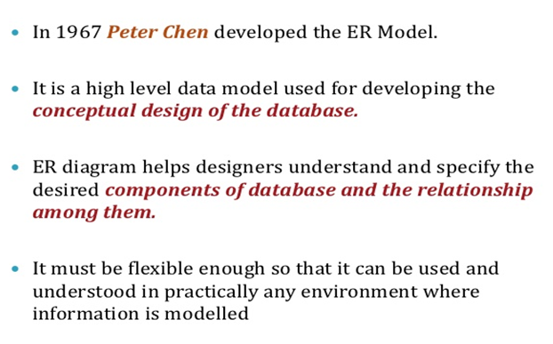
ENTITY RELATIONSHIP DIAGRAM

Slide 24
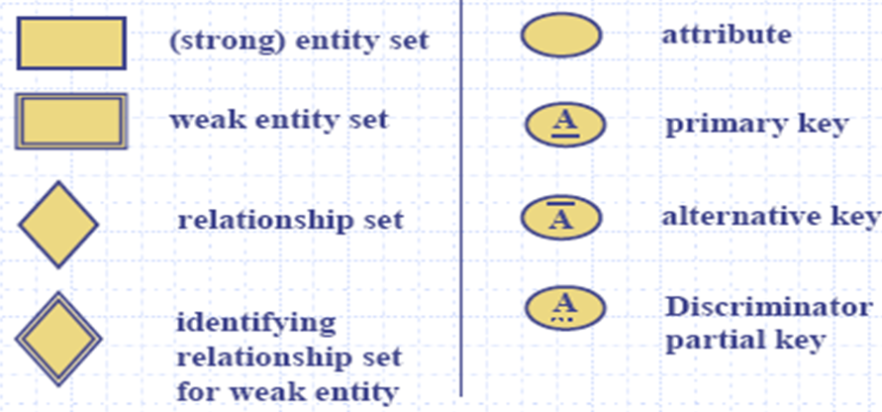
ER notations

Slide 25
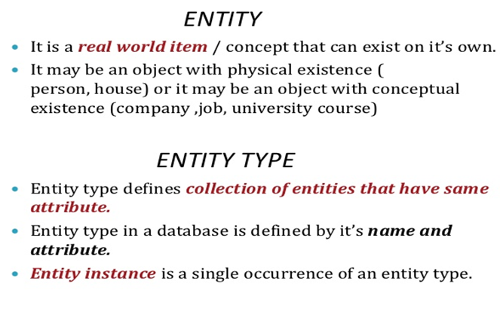
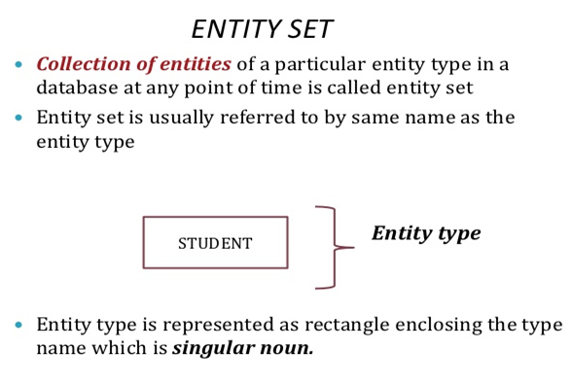
ENTITY in ER diagram

Slide 26
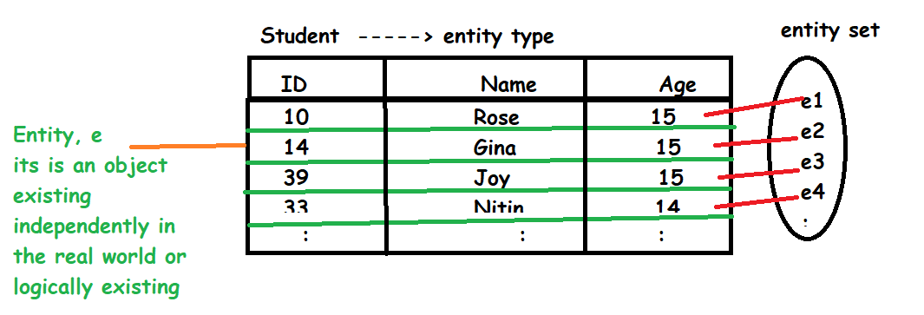
Example of entity and entity set
Student

Slide 27
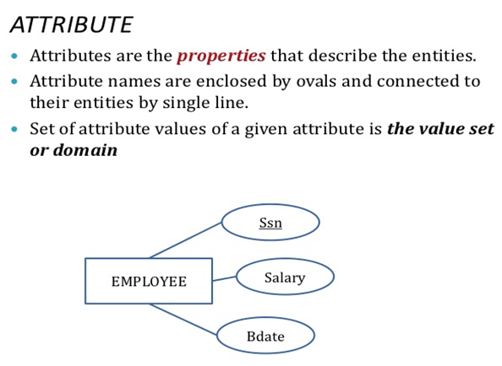
ATTRIBUTE in ER diagram
NULL values to attributes if that attribute doesn’t have value
e.g.,
FName = NULL
Nationality = NULL
Gender = NULL
2. Domain:
set of permitted values for that attribute.
E.g.,
dom(pval) -→ any between 0 to +1
dom (votecast_age) → any value from 18+

Slide 28
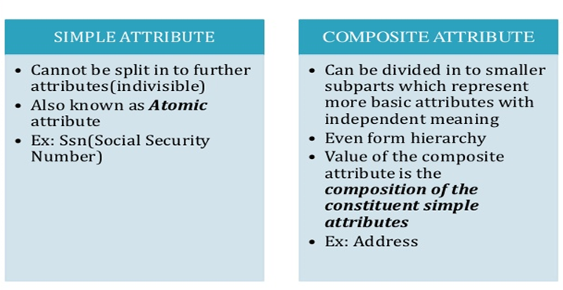
TYPES OF ATTRIBUTES

Slide 29
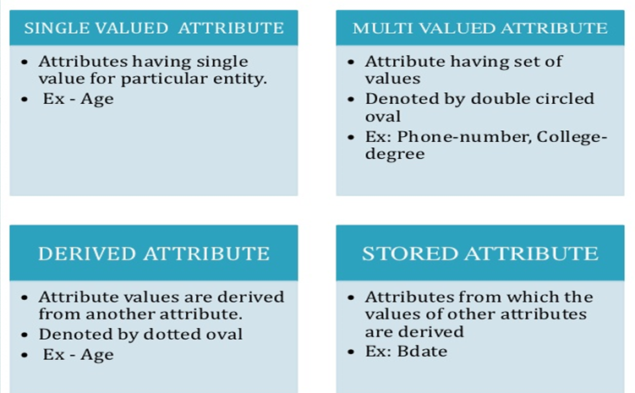
TYPES OF ATTRIBUTES (contd.)

Slide 30
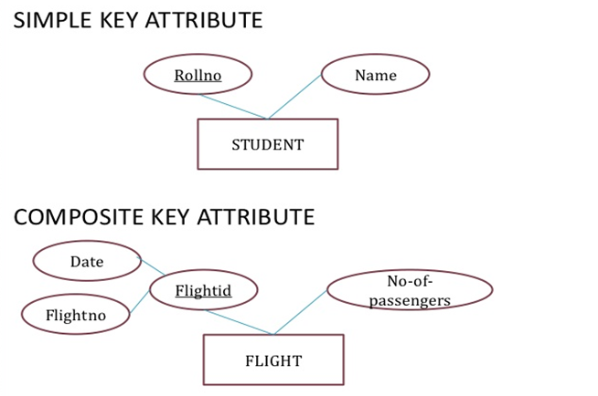
Attributes
NOTE:
Primary key will be underlined

Slide 31
KEYS
Entities and relationships are distinguishable using various keys
A key is a combination of one or more attributes, e.g., social-security number, combination of name and social-security number.
A superkey is a key defined either for an entity set or relationship set that uniquely identifies an entity,
e.g., social-security number, phone number, combination of name and social-security number. ( Note : UNIQUE and NOT NULL)
A candidate key is a minimal superkey that uniquely identifies either an entity or a relationship,
e.g., social-security number, phone number. ( Note : UNIQUE and NOT NULL)
A primary key is a candidate key that is chosen by the database designer to identify the entities of an entity set. ( Note : UNIQUE and NOT NULL)
A Composite key is a candidate key with more one attribute to identify the entities of an entity set.
eg., {stud_id, stud_email, stud_name}

Slide 32
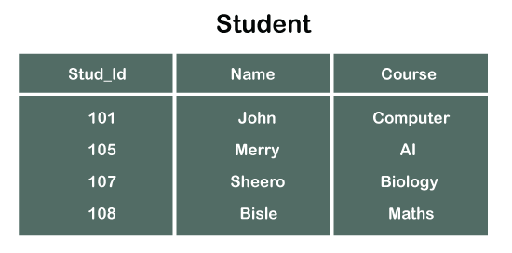
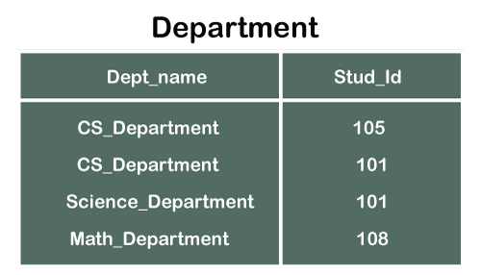
KEYS
A foreign key is a set of one or more attributes of a strong entity set that are employed to construct the discriminator of a weak entity set. The primary key of a weak entity set is formed by the primary key of the strong entity set on which it is existence-dependent.

Slide 33
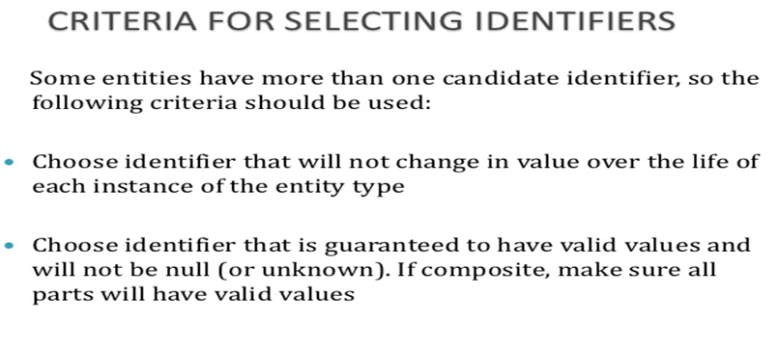
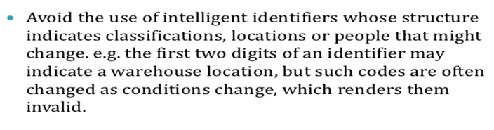
Attributes

Slide 34
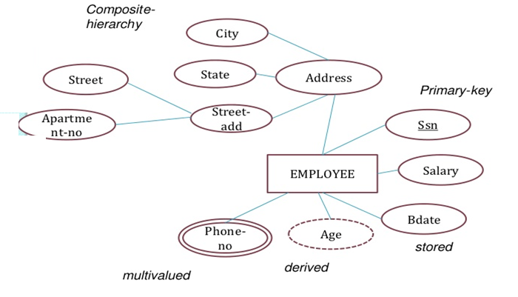
Attributes
Construct ER:
Employee has SSN, salary, Age, DOB,phone numbers, Address of each employee complete address has door# , bldg. ,street, area, city, state.

Slide 35
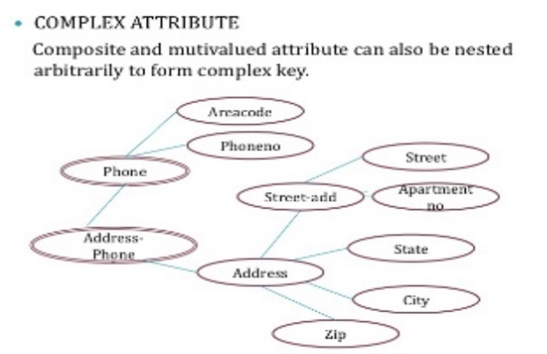
Attributes

Slide 36
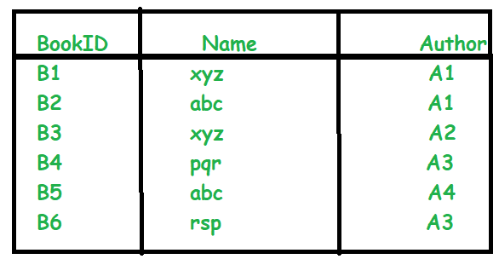
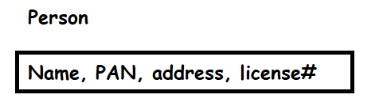
Answer these:
1.Determine the type of attributes in
Customer(name, age, addr, phno, DOB)
2. If an Employee can reside at the HQ and Bcity. Also that this addr is further divided as door#, street and city . What will this attribute addr be?
3. Consider the book table : find super key, Primary key, Candidate key.
4. For person entity find Pk,Ck?
5. If K1={ID} and K2{name, addr} which one should be Pk?
6. Find Composite Key attributes or alternate key attributes?
Order{ Custid, orderid, sales}
Student{ Sid, name, addr, mark}
book table

Slide 38
QUESTION???

Slide 39
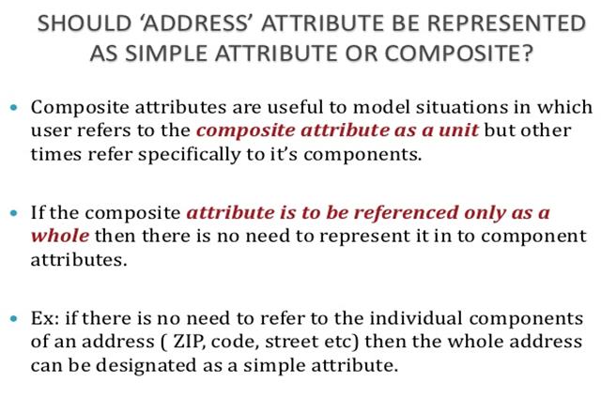
ER Models

Slide 40
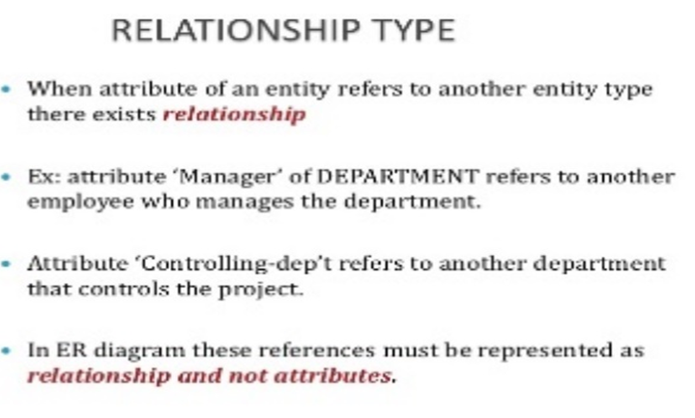
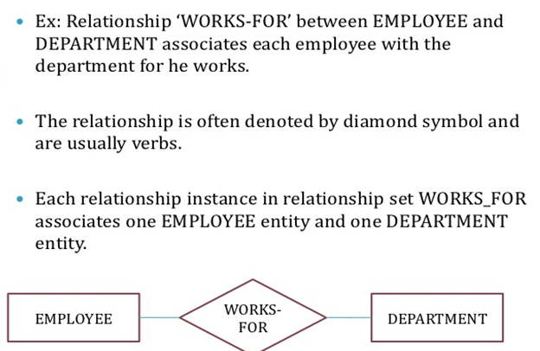


Relationship

Slide 41
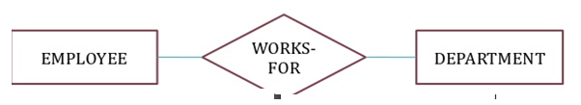
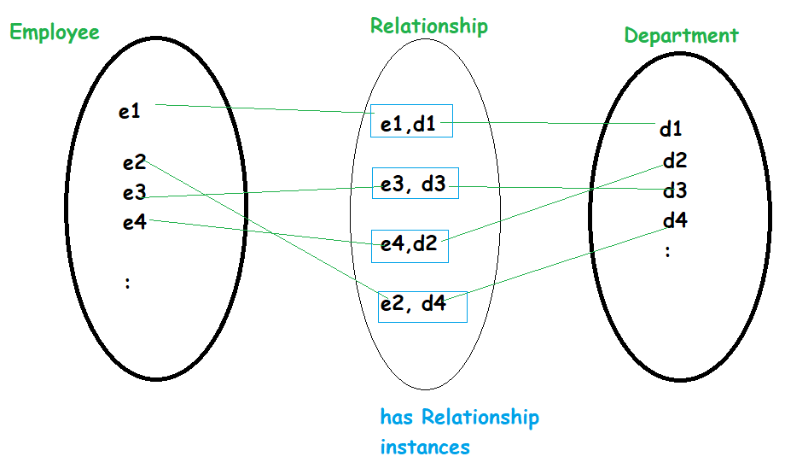
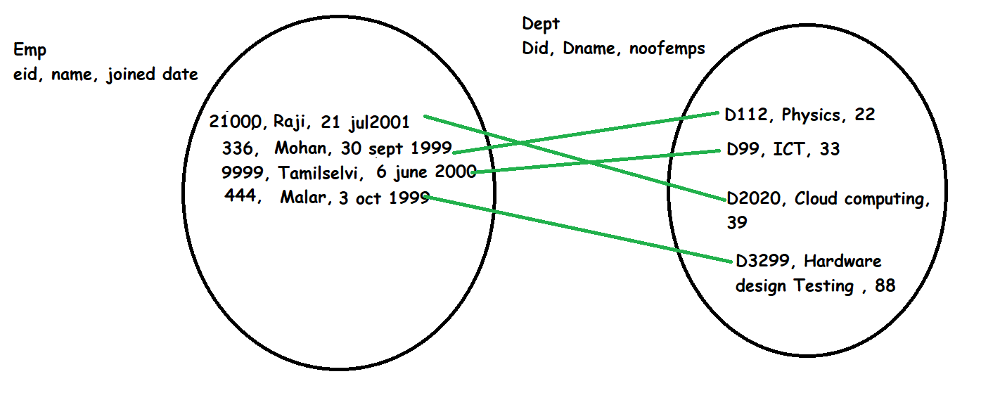
Relationship
1 1

Slide 42
Relationship
Relationships have:
Degree
How many entities of one entity is participating in the relation with how many entities of another entity called as mapping or cardinality constraint.
Role names
Participation constraints
5. Relationships can have attributes.

Slide 43
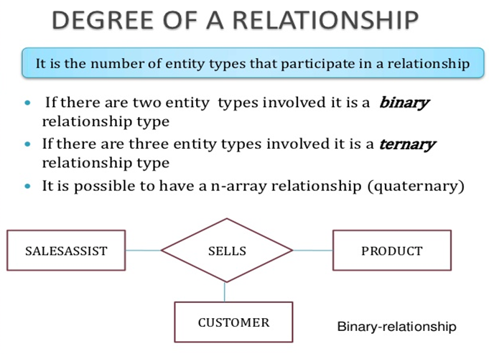
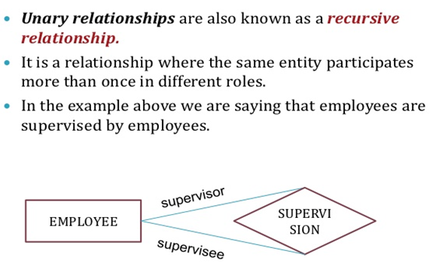
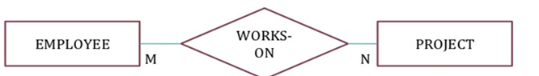
ER Models

Slide 44
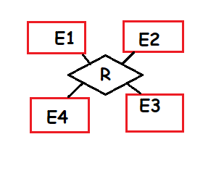
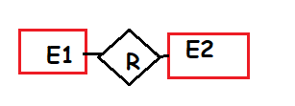
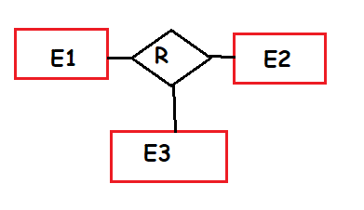
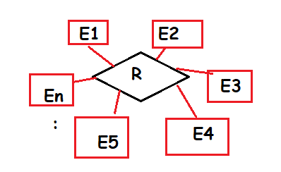
Types of Relationship based on degree of relation.
QUATERNARY
BINARY
TRENARY
N-NARY

Slide 45
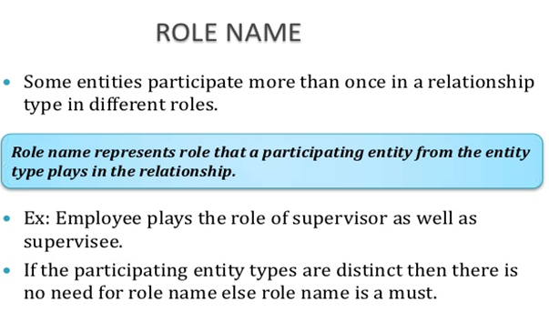
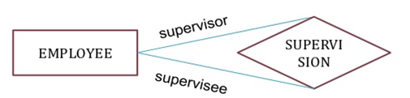
ER Models

Slide 46
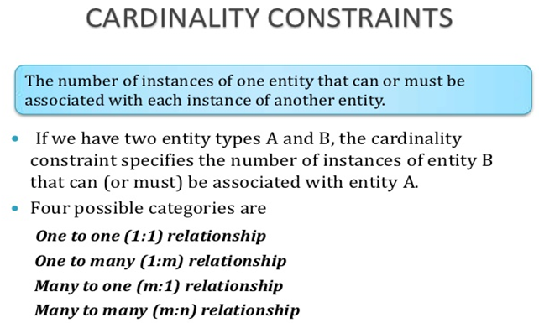
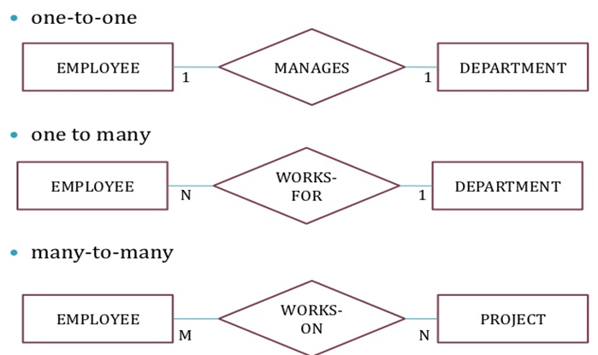
Mapping constraints
from employee entity ask ,Is 1 employee managing 1 department?
from dept entity ask ,Is 1 dept having one manager?

Slide 47
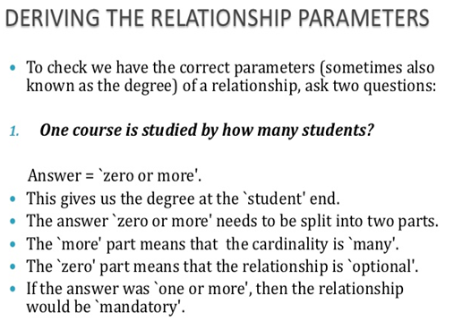
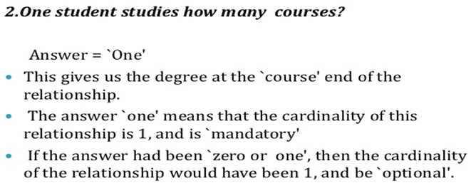
ER Model

Slide 48
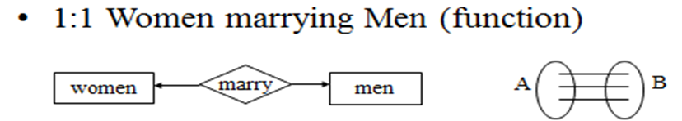
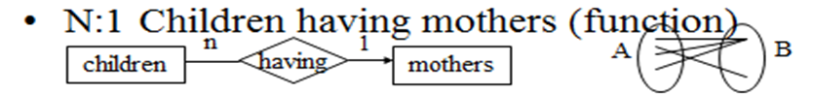
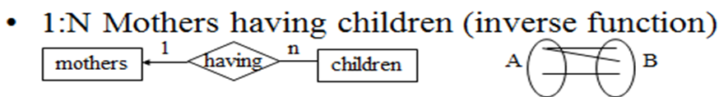
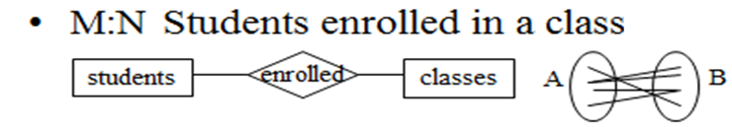
Mapping constraints

Slide 49
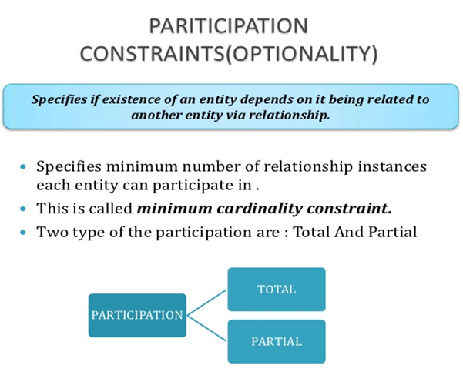
Participation constraints

Slide 50
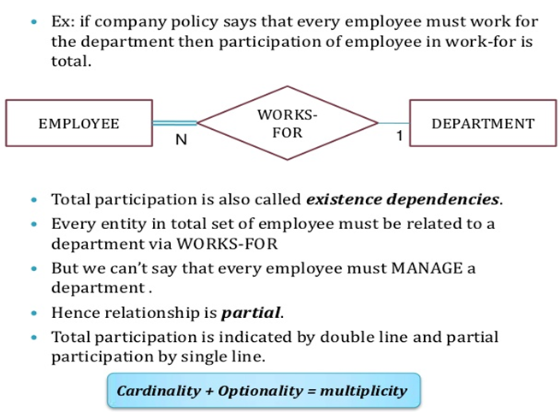
Participation constraints

Slide 51
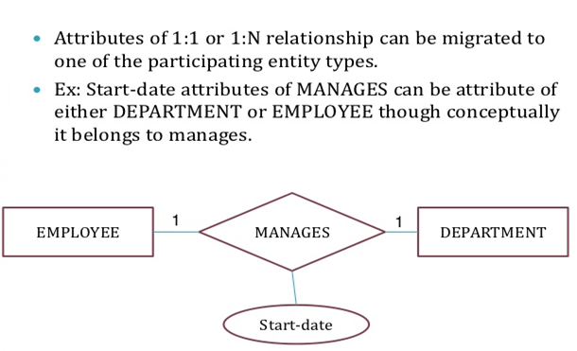




Relationship with attributes
Relationships can have Attributes which are intersecting two entities for 1:1 it can be on any entity side

Slide 52
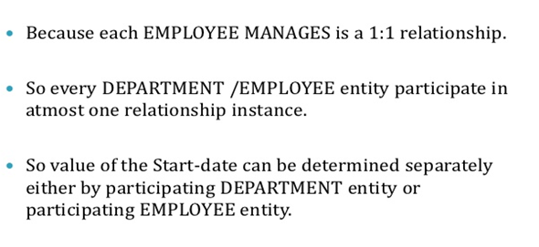
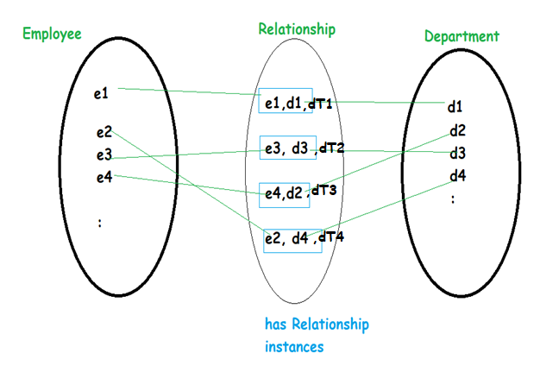
Relationship with attributes

Slide 53
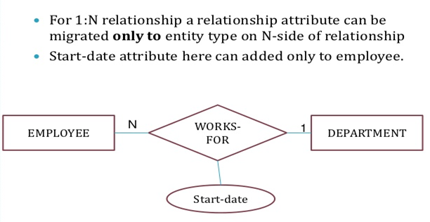


Relationship with attributes

Slide 54






Relationship with attributes

Slide 55



Multiplicity → cardinality + participation

Slide 56


ER models

Slide 57


ER notations for mapping constraints

Slide 58



Structural or MIN-MAX constraint
(m,n)
(m,n) ➔ says if m=0, then partial participation
→ if m=1 , then its total participation

Slide 59

ENTITY TYPES

Slide 60

ER Models

Slide 61

ER Models

Slide 62





ER Models
Pk ===➔ Fk

Slide 63

ER Models

Slide 64

ER Model

Slide 65




ER Model

Slide 66


BINARY and TERNARY
This Supplier supplied so many qty to pname
This partno supplied by which supplier
Ternary relationship gives for qty value for specified supplier , project and part data
Each binary relationship gives what happened between two entities data
This pname used
partno

Slide 67




Ternary Relationships

Slide 68






BINARY and TERNARY

Slide 69


BINARY and TERNARY
The ternary and binary have different meaning.
So when converting ternary to binary check if they mean the same.

Slide 70

Entities having more than 1 relationships

Slide 71


Redundant relationships

Slide 72

Entities having more than 1 relationships
Does this have any redundant relationship?

Slide 73

Aggregation
Relation between two entities is treated as a single entity.
In aggregation, relationship with its corresponding entities is aggregated into a higher level entity.
NOTE: we cannot connect two relationships directly instead use aggregation.
For e.g.,
Center entity offers the Course entity act as a single entity in the relationship which is in a relationship with another entity visitor.
In the real world, if a visitor visits a coaching center then he will never enquiry about the Course only or just about the Center instead he will ask the enquiry about both.

Slide 74


Aggregation

Slide 75



Questions
What are the redundant relationships in fig1 ?
2. Draw ER for Employee has name and id and works in a project for so many hours. Project has a name and employee uses many machines identified by mcid attribute.
3. Represent a scenario “employee who supervises other employees” in ER
4. Convert fig 2 into a 1:N relationships
5. What are the redundant relationships in fig3 ?
Fig 1
Fig 3
Fig 2

Slide 77


CONSTRUCTING ER Model
Notes:
1. Identify all the relevant entities in a given system and determine the relationships among these entities.
2. An entity should appear only once in a particular diagram.
3. Provide a precise and appropriate name for each entity, attribute, and relationship in the diagram. Terms that are simple and familiar always beats vague, technical-sounding words. In naming entities, remember to use singular nouns. However, adjectives may be used to distinguish entities belonging to the same class (part-time employee and full time employee, for example). Meanwhile attribute names must be meaningful, unique, system-independent, and easily understandable.
4. Remove vague, redundant or unnecessary relationships between entities.
5. Never connect a relationship to another relationship.
6. Make effective use of colors. You can use colors to classify similar entities or to highlight key areas in your diagrams.

Slide 78


CONSTRUCTING ER Model
Notes:
1. Identify all the relevant entities in a given system and determine the relationships among these entities.
2. An entity should appear only once in a particular diagram.
3. Provide a precise and appropriate name for each entity, attribute, and relationship in the diagram. Terms that are simple and familiar always beats vague, technical-sounding words. In naming entities, remember to use singular nouns. However, adjectives may be used to distinguish entities belonging to the same class (part-time employee and full time employee, for example). Meanwhile attribute names must be meaningful, unique, system-independent, and easily understandable.
4. Remove vague, redundant or unnecessary relationships between entities.
5. Never connect a relationship to another relationship.
6. Make effective use of colors. You can use colors to classify similar entities or to highlight key areas in your diagrams.

Slide 79

CONSTRUCTING ER Model
Notes:
1. Identify all the relevant entities in a given system and determine the relationships among these entities.
2. An entity should appear only once in a particular diagram.
3. Provide a precise and appropriate name for each entity, attribute, and relationship in the diagram. Terms that are simple and familiar always beats vague, technical-sounding words. In naming entities, remember to use singular nouns. However, adjectives may be used to distinguish entities belonging to the same class (part-time employee and full time employee, for example). Meanwhile attribute names must be meaningful, unique, system-independent, and easily understandable.
4. Remove vague, redundant or unnecessary relationships between entities.
5. Never connect a relationship to another relationship.
6. Make effective use of colors. You can use colors to classify similar entities or to highlight key areas in your diagrams.

Slide 80
ER design steps
Identify nouns as it becomes entity types.
Identify all attributes of each entity type.
Mark the Pk ,partial keys (if it exists) for each entity type.
3 a. Identify if entity type is weak or strong.
4. Identify the verbs from problem statement which becomes Relationships.
a. determine the degree of relationship as unary, binary or ternary
b. determine Mapping constraints or cardinality constraint as 1:1,1:N or N:1 , M:N
c.. Determine Participation constraint as total or partial
d.. Relationship is weak only if one entity type in the relationship is weak
e. determine if we have multiple relations.
f. determine rolename if any.
g. determine if relationship has any attributes.
h. Redundant relationships and removing the redundancy.
5. Determine any aggregation is needed
6. Loop 1 to 5 until the design is acceptable (ie., only when it captures all data in problem statement).

Slide 81
ER design points
When developing an ER diagram presents several choices, including the following:
Should a concept be modelled as an entity or an attribute?
Should a concept be modelled as an entity or a relationship?
What are the relationship sets and their participating entity sets? Should we use
binary or ternary relationships?
Should we use aggregation
• ER design is subjective. There are often many ways to model a given scenario. Analyzing alternatives can be tricky, especially for a large enterprise.
• Common choices include:
Entity vs. attribute
Key for the entity / to store or discard an attribute
Entity vs. relationship
Binary or n-ary relationship
Use of ISA hierarchies (used in EER)
Use of aggregation

Slide 82

Business Rule:

Slide 83
Example 1 design ER
Consider a mail order database in which employees take orders for parts from customers. The data requirements are summarized as follows:
The mail order company has employees identified by a unique employee number, their first and last names, and a zip code where they are located.
Customers of the company are uniquely identified by a customer number.
In addition, their first and last names and a zip code where they are located are recorded.
The parts being sold by the company are identified by a unique part number. In addition, a part name, their price, and quantity in stock are recorded.
Orders placed by customers are taken by employees and are given a unique order number. Each order may contain certain quantities of one or more parts and their received date as well as a shipped date is recorded.
Design an Entity-Relationship diagram for the mail order database.

Slide 84

Solution
Step 1: Identify the Entities: Employee, Customer, Parts, Order
Step 2: Identify the attributes of each entity:
Employee => enum, fname, lname, zipcode
Customer => custnum, fname,lname,zipcode
Parts => partnum, price, qtyinhand
Order =>ordernum,recvddate, partnum,qty,shippeddate
Step 3:
Consider the “The mail order company has employees identified by a unique employee number, their first and last names, and a zip code where they are located”

Slide 85


Solution
Step 4 :
2.Consider the “ Customers of the company are uniquely identified by a customer number. In addition, their first and last names and a zip code where they are located are recorded.”
Step 5 :
3.Consider the “The parts being sold by the company are identified by a unique part number. In addition, a part name, their price, and quantity in stock are recorded.”

Slide 86


Solution
Step 6 :
4. consider the “Orders placed by customers are taken by employees and are given a unique order number. Each order may contain certain quantities of one or more parts and their received date as well as a shipped date is recorded.”
BR 1 employee serves only one customer at a time
What if BR is 1 employee can server more than 1 customer at a time ?

Slide 87



Example 2
UPS prides itself on having up-to-date information on the processing and current location of each shipped item. To do this, UPS relies on a company-wide information system. Shipped items are the heart of the UPS product tracking information system. Shipped items can be characterized by item number (unique), weight, dimensions, insurance amount, destination, and final delivery date. Shipped items are received into the UPS system at a single retail center. Retail centers are characterized by their type, uniqueID, and address. Shipped items make their way to their destination via one or more standard UPS transportation events (i.e., flights, truck deliveries). These transportation events are characterized by a unique scheduleNumber, a type (e.g, flight, truck), and a deliveryRoute. Please create an Entity Relationship diagram that captures this information about the UPS system. Be certain to indicate identifiers and cardinality constraints.

Slide 88

Solution

Slide 89
Problem
A database is being constructed to keep track of the teams and games of a sports league. A team has a number of players, not all of whom participate in each game.
It is desired to keep track of the players participating in each game for each team, the positions they played in that game, and the result of the game. Try to design an ER schema diagram for this application, stating any assumptions you make.
Choose your favorite sport (soccer, football, baseball ...).

Slide 90

Solution
For a baseball league

Slide 91

Example 2 design ER Model

Slide 92


Example of CONSTRUCTION ER Model

Slide 93


Example of CONSTRUCTION ER Model

Slide 94

Example of CONSTRUCTION ER Model

Slide 95
Practice ER question
A friend is interested in keeping track of information about his album collection. He is not concerned about whether or not the albums are CDs, tapes, LPs, etc.
Also, assume that he does not have any compilation albums—that is, each album has songs from a single band.
For each album, he wants to store which band recorded the album, the title, the year, and the chronology (e.g. this is the 4th album for that band). He also wants to store the songs, including title, length, track number, and writer(s).
Of course, if two bands record the same song, they might have different track numbers and lengths. For each band (group or individual), he also wants to store the names of all of the band members. For each band member, he needs their first and last names, and country of origin.
Consider both band members and songwriters as musicians.

Slide 96

Solution

Slide 97
EER Design

Slide 98
EER Model
EER is a high-level data model that incorporates the extensions to the original ER model. It is a diagrammatic technique for displaying the following concepts
Sub Class and Super Class
Specialization and Generalization
Union or Category
Aggregation
These concepts are used when the comes in EER schema and
the resulting schema diagrams called as EER Diagrams.

Slide 99
EER advantages
Features of EER Model
EER creates a design more accurate to database schemas.
It reflects the data properties and constraints more precisely.
It includes all modeling concepts of the ER model.
Diagrammatic technique helps for displaying the EER schema.
It includes the concept of specialization and generalization.
It is used to represent a collection of objects that is union of objects of different of different entity types.
So when do you use ER and EER?
EER is perfect for taking a more detailed look at your huge amount of information. Ie.,When your database contains a larger amount of data it is best to turn to an enhanced model to more deeply understand your data and complexity.

Slide 100


Sub and Super class
Sub Class and Super Class
Sub class and Super class relationship leads the concept of Inheritance.
The relationship between sub class and super class is denoted with d or O symbol.
1. Super Class
Super class is an entity type that has a relationship with one or more subtypes.
An entity cannot exist in database merely by being member of any super class. For example: Shape super class is having sub groups as Square, Circle, Triangle.
2. Sub Class
Sub class is a group of entities with unique attributes.
Sub class inherits properties and attributes from its super class. For example: Square, Circle, Triangle are the sub class of Shape super class.

Slide 101


EER Model with sub and super class

Slide 102


Super and Sub classes

Slide 103

Specialization
Specialization is a process that defines a group entities which is divided into sub groups based on their characteristic.
It is a top down approach, in which one higher entity can be broken down into two lower level entity.
It maximizes the difference between the members of an entity by identifying the unique characteristic or attributes of each member.
It defines one or more sub class for the super class and also forms the superclass/subclass relationship.

Slide 104


Specialization

Slide 105


Specialization

Slide 106

Generalization
Generalization is the process of generalizing the entities which contain the properties of all the generalized entities.
It is a bottom approach, in which two lower level entities combine to form a higher level entity.
Generalization is the reverse process of Specialization.
It defines a general entity type from a set of specialized entity type.
It minimizes the difference between the entities by identifying the common features.

Slide 107


Generalization example

Slide 108

Constraints on Specialization and Generalization

Slide 109

Constraints on Specialization and Generalization

Slide 110



Predicate defined subclasses
if the EMPLOYEE entity type has an attribute Job_type, as shown in Figure. we can specify the condition of membership in the SECRETARY subclass by the condition (Job_type = ‘Secretary’), which we call the defining predicate of the subclass. This condition is a constraint specifying that exactly those entities of the EMPLOYEE entity type whose attribute value for Job_type is ‘Secretary’ belong to the subclass.

Slide 111



Attribute defined subclasses
If all subclasses in a specialization have their membership condition on the same attribute of the superclass, the specialization itself is called an attribute-defined specialization, and the attribute is called the defining attribute of the specialization. In this case, all the entities with the same value for the attribute belong to the same sub-class

Slide 112


User defined Subclass
If a DB user has an entity “A” to add to the database, then he can use his understanding of the mini -world to determine to which subclass entity “A” should be added.

Slide 113
Note:
In EER:
– The “name” of the defining attribute is written on the line going “out of” the superclass.
– The “value” of the defining attribute is written on the line going “into” the subclass
The attribute which determines membership to a subclass is called “Defining Attribute”.
– Example: attribute “JobType”
• The condition which determines membership to a subclass is called “Defining Predicate”.
– Example: JobType=‘secretary’
• If membership to a subclass is determined using value of some attribute, then this subclass is called “Predicate Defined Subclass”.
• If all subclasses of a specialization have their membership condition on the same attribute, then the specialization is called “Attribute-Defined Specialization

Slide 114

Constraints on Specialization and Generalization

Slide 115
EER Model with Disjoint and Overlapping subclasses

Slide 116

Specialization and Generalization Hierarchies and Lattices
A specialization hierarchy has the constraint that every subclass participates as a subclass in only one class/subclass relationship; that is, each subclass has only one parent, which results in a tree structure or strict hierarchy.
In contrast, for a specialization lattice, a subclass can be a subclass in more than one class/subclass relationship.

Slide 117

Recap of Inheritance ….

Slide 118

EER Models

Slide 119

EER Models

Slide 120

EER Models

Slide 121

EER Models with specialization and generalization (UNIVERSITY)

Slide 122


Category or Union type
Category represents a single super class or sub class relationship with more than one super class.
It can be a total or partial participation.

Slide 123

Union example

Slide 124
UNION or CATEGORY:
In some cases, a single class has a similar relationship with more than one class.
For example, the sub class ‘car’ may be owned by two different types of owners:
INDIVIDUAL or ORGANISATION. Both these types of owners are different classes thus such a situation can be modelled with the help of a Union.
UNION comes into play when you want to represent two or more superclass for a subclass.

Slide 125

Note on CRUD in EER:

Slide 126
EER design steps
1. Specialization: extracting a subclass from an entity set.
2. Generalization: combining one or more entity sets into a higher level entity.
a. Disjoint generalization: an entity belongs to at most one lower level entity set.
b. Overlapping generalization: entities may belong to multiple lower level entities.
c. Hierarchy: each entity set is only the object of one “ISA” relationship.
3. Lattice: entity sets may belong to multiple “ISA” relationships.
4. Condition-defined constraint: defines membership in a subclass via a predicate.
User-defined constraint: membership is manually defined.
Completeness constraint: all entities belong to a lower level entity.
Total constraint: all entities belong to lower level entity sets.
Partial Constraint: entities not required to belong to lower level entity set.
5. Aggregation: grouping part of a schema into a larger unit.
6. LOOP from ER1 to EER 5 until design is accepted.

Slide 127
EER design points
When developing an ER diagram presents several choices, including the following:
Should a concept be modelled as an entity or an attribute?
Should a concept be modelled as an entity or a relationship?
What are the relationship sets and their participating entity sets? Should we use
binary or ternary relationships?
Should we use aggregation
• ER design is subjective. There are often many ways to model a given scenario. Analyzing alternatives can be tricky, especially for a large enterprise.
• Common choices include:
Entity vs. attribute
Key for the entity / to store or discard an attribute
Entity vs. relationship
Binary or n-ary relationship
Use of ISA hierarchies (EER )
Use of aggregation

Slide 128
Example EER design.
The EER diagram below describes the database of a training center, including information about its members, training activities and bookings.
Each member is identified through his/her e-mail address. Gold-members can book any training activity, while common members can only book core activities.
For each training activity, the database stores the schedule (week, week day, and time), the room, the leader and the e-mail of the leader. Each leader leads several activities per week, but the same activities every week.
Translate the EER diagram into a relational model. Mark each primary key with a straight underline, and each foreign key with a dotted underline. For the foreign keys, mark the attributes that are referred by the foreign keys by means of arrows

Slide 129
Solution

Slide 130
Example 2:
A nonprofit organization depends on a number of different types of persons for its successful operation. The organization is interested in the following attributes for all of these persons: SSN, name, Address, City, State, Zip and Telephone. Three types of persons are of greatest interest: employees, volunteers, and donors. Employees have only a Date Hired attribute, and volunteers have only a Skill attribute. Donors have only a relationship (named Donates) with an Item entity type. A donor must have donated one or more items, and an item may have no donors, or one or more donors. There are persons other than employees, volunteers, and donors who are of interest to the organization so that a person may not belong to any of these three groups and may also belong to more than one group at the same time.

Slide 131

Solution

Slide 132
Example 4
Consider a bank, and model the following two aspects:
• There are three different kinds of ACCOUNTs, namely SAVINGS_ACCTs, CHECKING_ACCTs and TRUSts. For each ACCOUNT we have to take care of its TRANSACTIONs.
Each TRANSACTION has a type such as “deposit”, “withdrawal” or “check”. Furthermore, each transaction has a date/time (consisting of a date and a time) and an amount.
• There are different kinds of LOANS, namely CAR_LOANS, HOME_LOANS, CREDIT_LINE and PERSONAL ones. For each LOAN we have to take care of its PAYMENTs. Each PAYMENT has a type, date and amoun

Slide 133

Solution

Slide 134

EER Models Design: Example 3

Slide 135

EER Models Design: Example

Slide 136

EER Models Design: Example

Slide 137

EER Models Design: Example

Slide 138

EER Models Design: Example

Slide 139

EER Models Design: Example

Slide 140
SUMMARY
Database design Phases.
Conceptual Design.
ER diagram.
EER diagram.

